Slide 1

Scenario Prefetch

Slide 2
Scenario
Prefetch
Created By Microsoft to speed up the system boot, recover from hibernation, and launch applications
Prefetching speeds up computer performance by bringing the data and code pages of programs used during the boot process and in subsequent program launches into memory from the disk before that data and code is actually demanded
Prefetch files
files that are created as a result of the tracing what files are called for during system boot and application launch
Found in the folder
%WINDOWS%\Prefetch
File’s name is the name of the application to which the trace applies followed by a dash and the hexadecimal representation of a hash of the file’s path, ending with the .PF file extension

Slide 3
Scenario
This script was created to parse Windows Prefetch files
Supports prefetch files ranging from Windows XP to Windows 10
Issue:
Locate Prefetch directory and extract prefetch file of interest
Use entire Prefetch directory to extract information contained within prefetch files
Find valuable information
Date and time
Run counts
Volume information
Directory strings
Solution:
Python and scripting

Slide 4
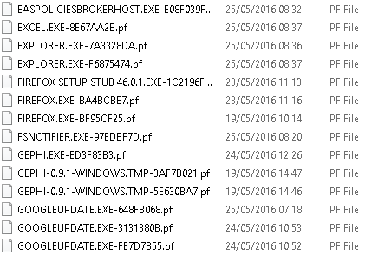
Scenario
Prefetch
It happens to be one of the more beneficial forensic artefacts regarding evidence of application execution

Slide 5
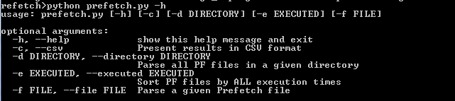
Scenario
Locate prefetch folder in Windows OS (%root%/Windows/Prefetch)
Or find prefect files in the folder called „Prefetch” provided by your teacher
Find the script called prefetch.py
Located in the same folder as prefetch files
Run it in the CMD with „-h” option
python prefetch.py -h

Slide 6
Scenario
Examine the results
Take a look of results provided by the Python script
Save results in .csv file
HINT – run the script with a „ -h ” option and see what command prints results in .csv file

Slide 7
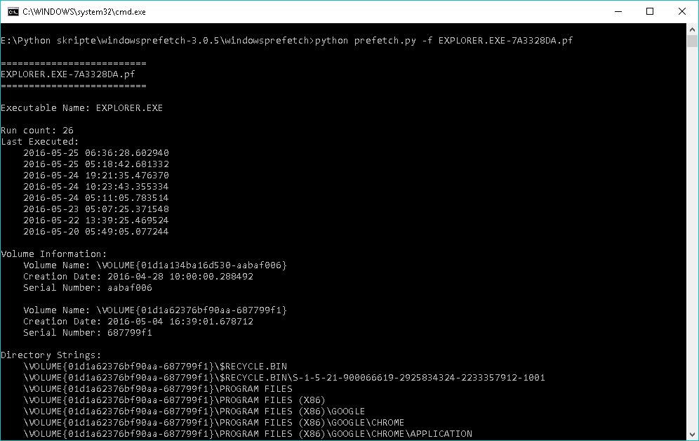
Scenario
Running Python script with 1 .pf file
Excelent script for parsing and analyzing prefetch files
Name of the .pf file

